Slide 1
Equipment calibration

Slide 2
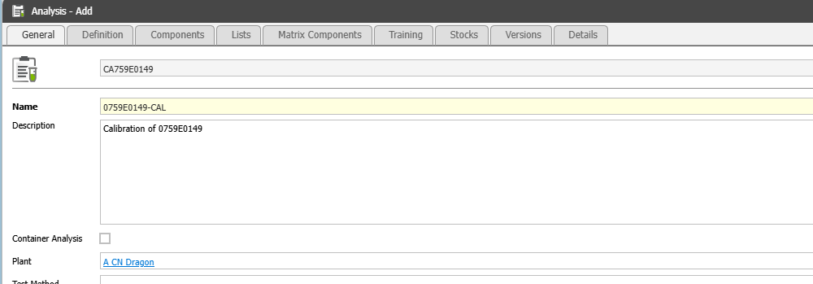
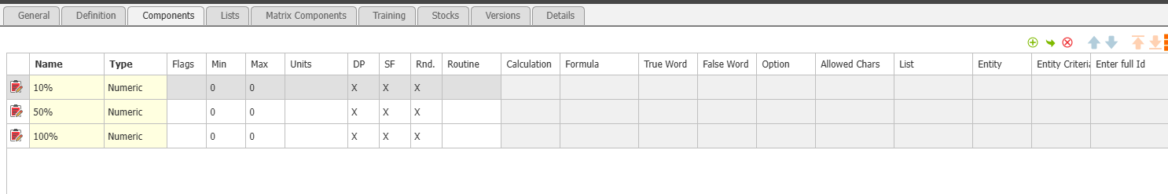
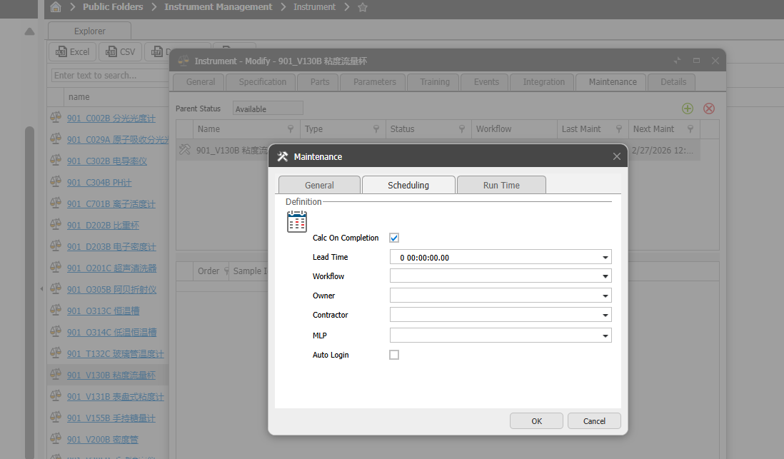
Calibration MASTER DATA
Master data –
Analysis to be created specifying test parameters at equipment level. Need a provision to add the frequency of testing. Based on frequency of testing – test items should be added. If the frequency of testing is 2, all test items in the below table have to displayed twice, so that user can record it accordingly. Some of the test items needs to be calculated field like the average of first 2, test items results. We also need “Info field” an option for free text entry.
Map analysis with equipment. Modify MLP as “Analysis”. User has to do map the instrument to analysis. Enter the details of “Owner” and “Contractor” if we need to send email or auto task assignment is required.

Slide 3
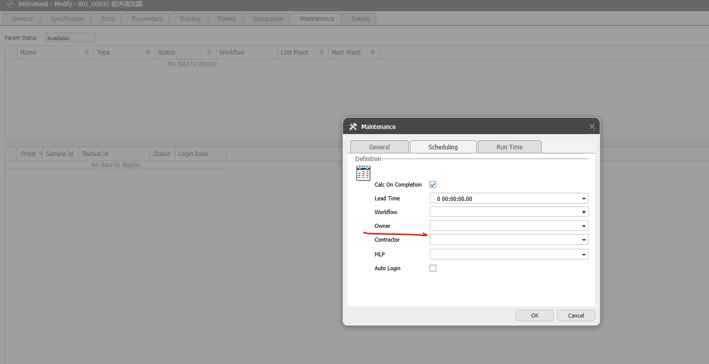
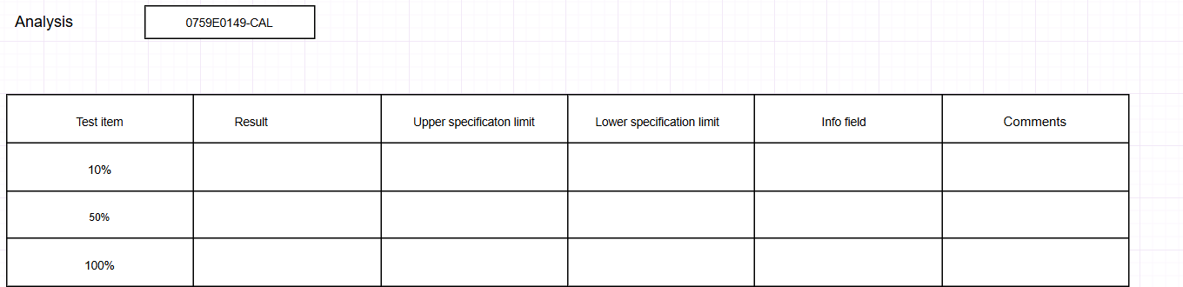
Performing Internal calibration
Task automatically created under “Internal calibration” folder of “Instruments” when the date of calibration arrives(in case there is a lead, it should also be considered). If a plant is configured to get an email need to send to operator who are configured at “Owner” in the maintenance master data.
User has to right click the task and “Perform calibration” and the task to be assigned to operator.
On clicking, pop-up screen appears. Analysis get auto populated and test items, Info field are pulled from Analysis. User has to input the result and specification limits and click on “Submit”.
If user does not perform test item, there should be a provision to cancel it.
User submits and confirm whether the calibration is passed or failed. After submission, workflow to be continued as in slide 5.

Slide 4

External calibration
Task automatically created under “External calibration” folder of “Instruments” when the date of calibration arrives(in case there is a lead, it should also be considered)
System needs to send out an email to “Contractor” and “Owner” of calibration when the lead date is approached and task to be created in QCLAD and assigned to operator under “Owner”. This email sending should be configured at plant level.
After external calibration, operator has to upload the external calibration results and follow the workflow as shown in next slide.

Slide 5
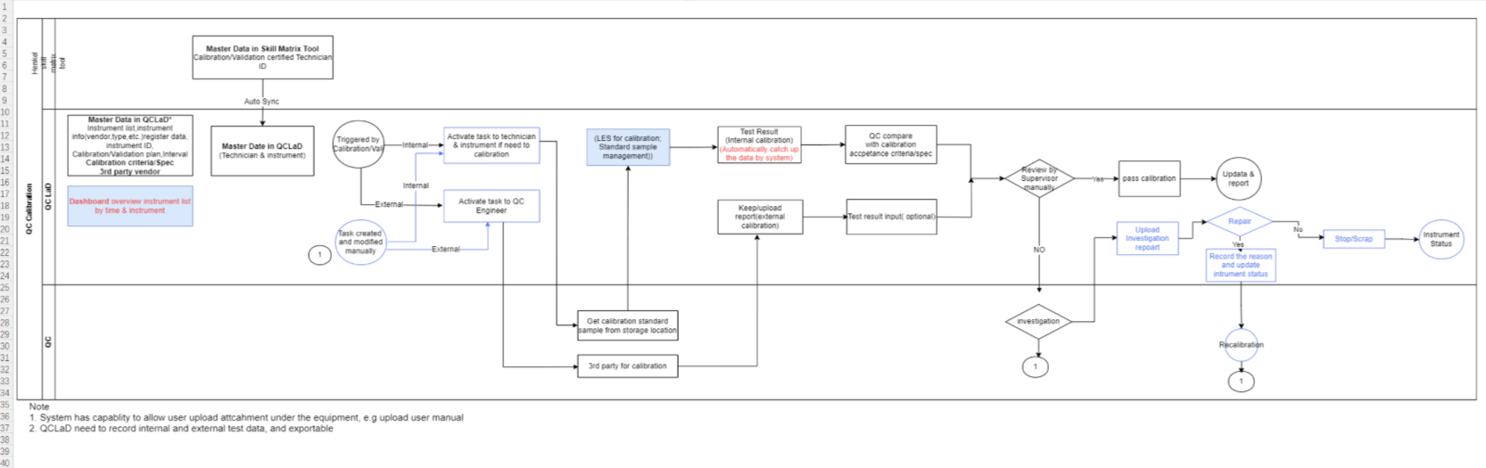
Email sending for internal and external calibration initiation to be configured at plant level
Review should be configured at plant/calibration type(internal or external)

Slide 6
THANK YOU.

